Slide 1
Coding seminar
26/07/2023
Lesson 3: More calculation, API, Git
Ikue Hirata, PhD
ikue.hirata@iit.it

Slide 2






Contents
Calculation: cook 2D data
API: use of external apps
Git: version control and collaboration

Slide 3
Calculation
Complex numbers
Fitting

Slide 4
Practical use case
Suppose…
You have several .csv data
Run fitting on these and extract parameters
Plot the data with fit line
Save all extracted parameters in one file and compare

Slide 5
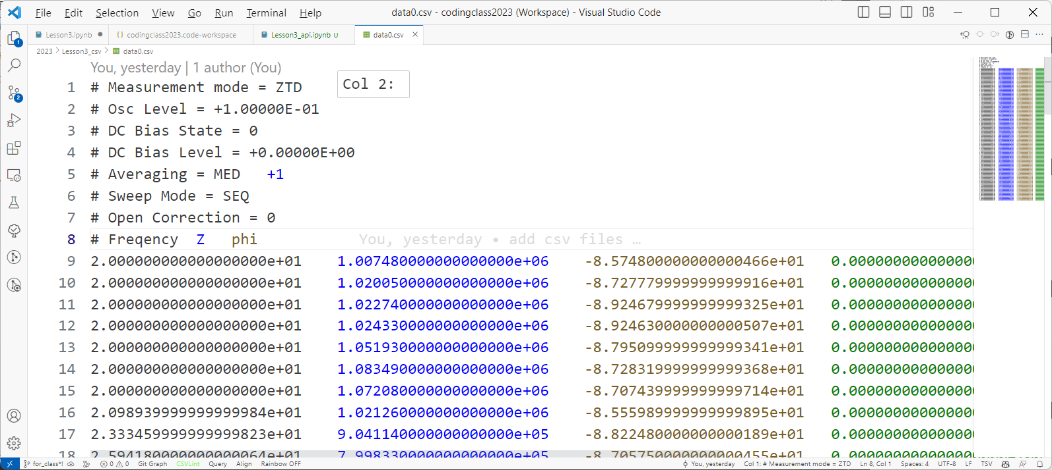
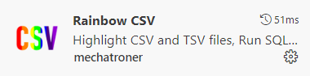
Sample data
Header/comments
Data body

Slide 6
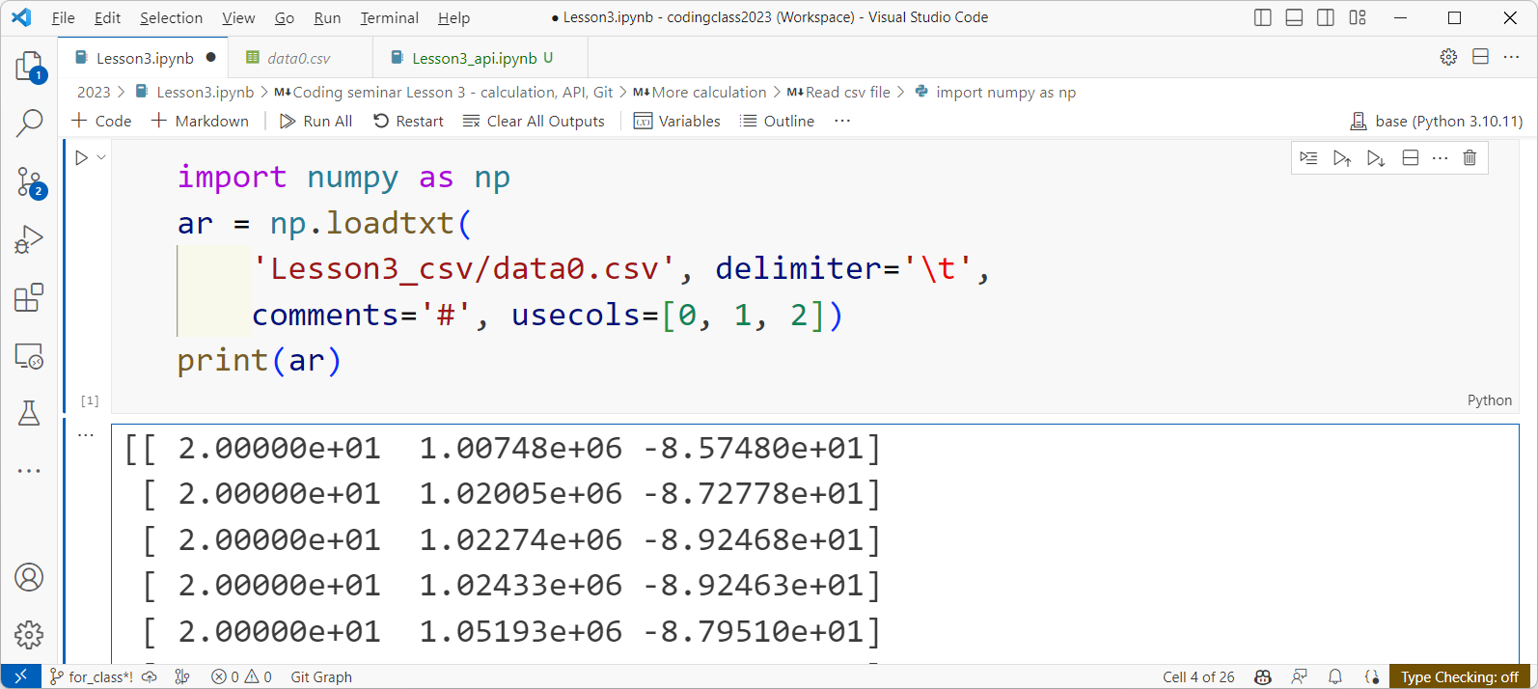
Read data into array

Slide 7
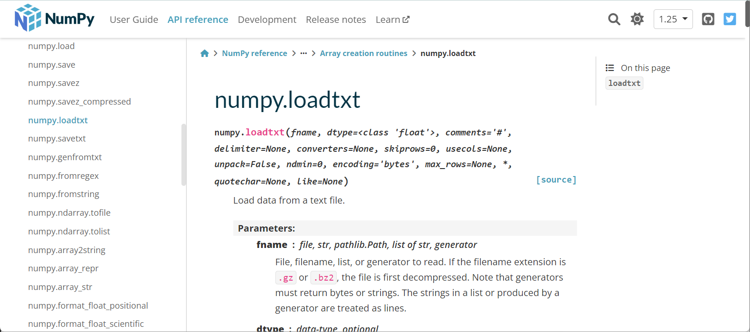
For more options…
https://docs.scipy.org/doc/numpy/reference/generated/numpy.loadtxt.html

Slide 8
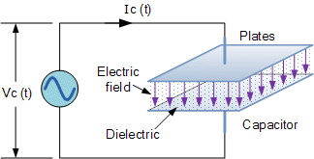
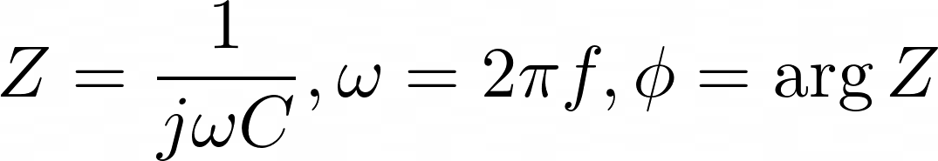



What is this?
Complex impedance of a capacitor
https://www.electronics-tutorials.ws/filter/filter_1.html
We want to get this value
j as imaginary number

Slide 9
Which value is which?
f
Z
ϕ

Slide 10
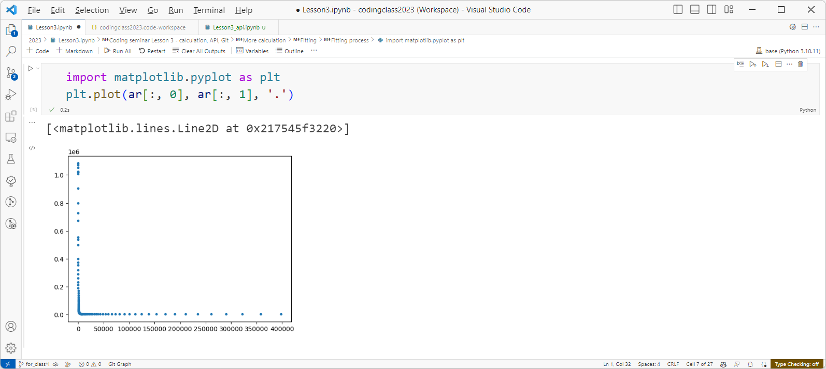
Plot to see data

Slide 11
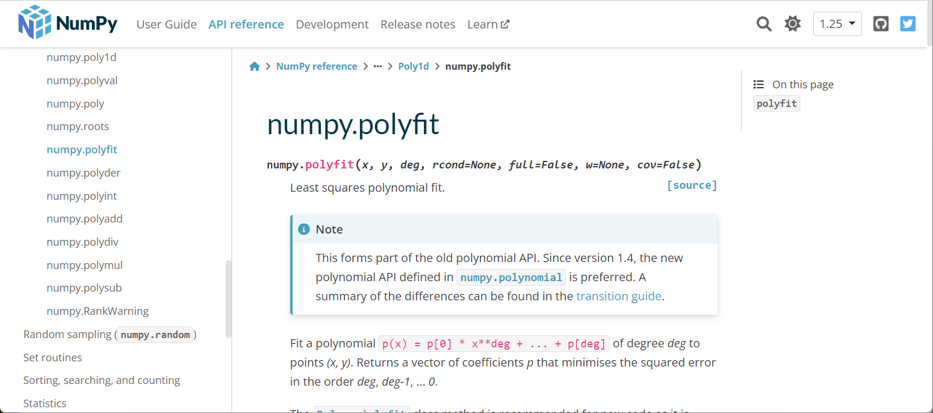
Fitting function
https://numpy.org/doc/stable/reference/generated/numpy.polyfit.html

Slide 12
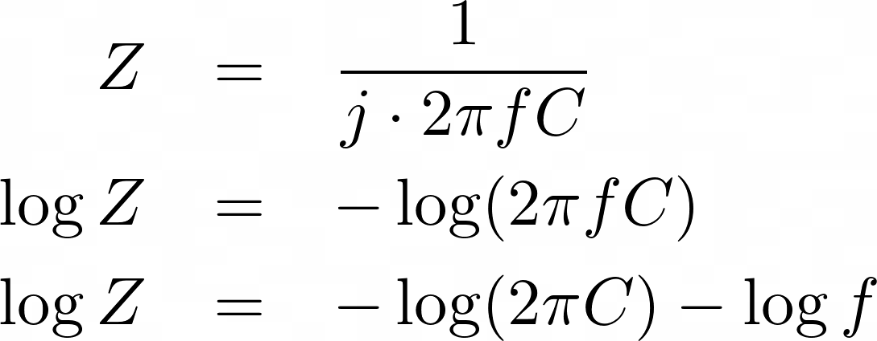


Small trick to make calculation easy
X
Y

Slide 13
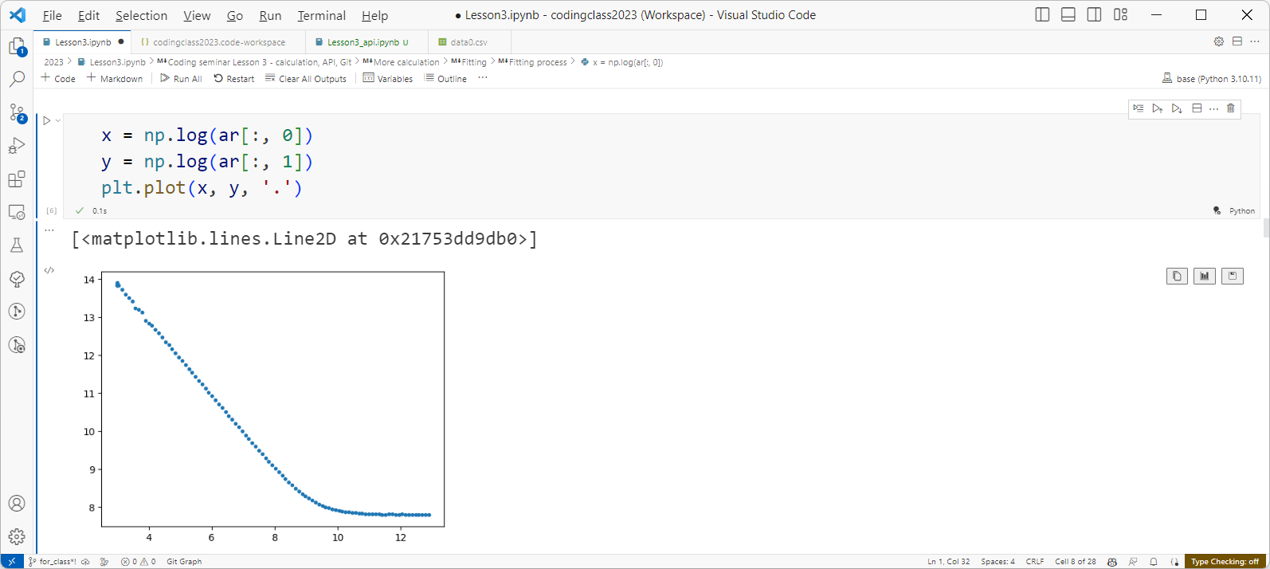

Plot transformed data
This region looks nice to fit (arbitrary)

Slide 14
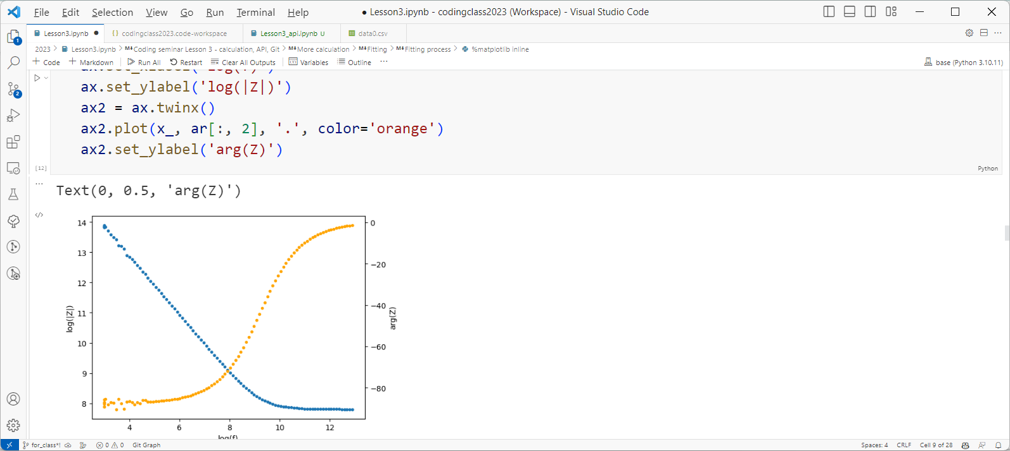

Define “good” fitting range
Fit where arg(Z) < -80

Slide 15
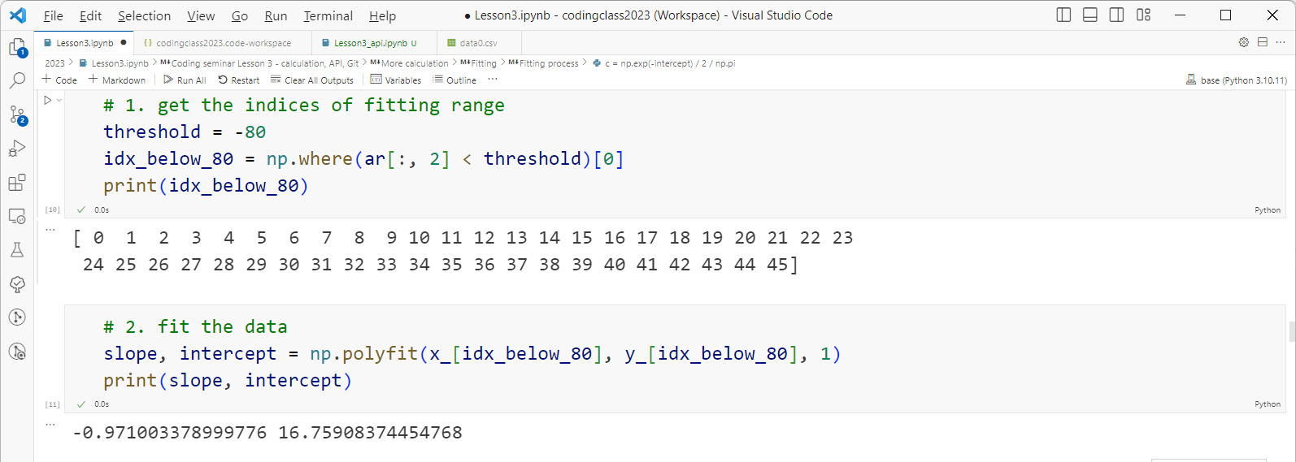

Fitting

Slide 16
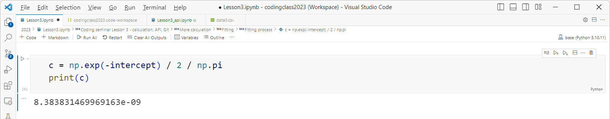
Calculate C

Slide 17
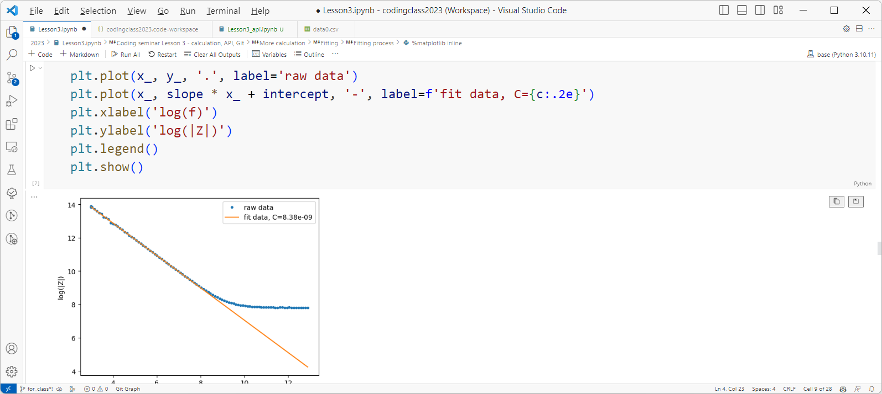

Add fit line

Slide 18
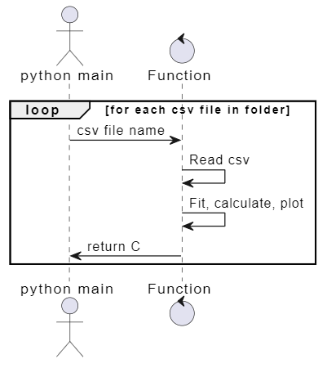
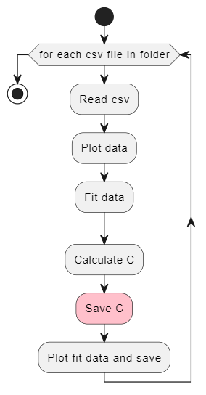
Processing multiple files
Spit out

Slide 19
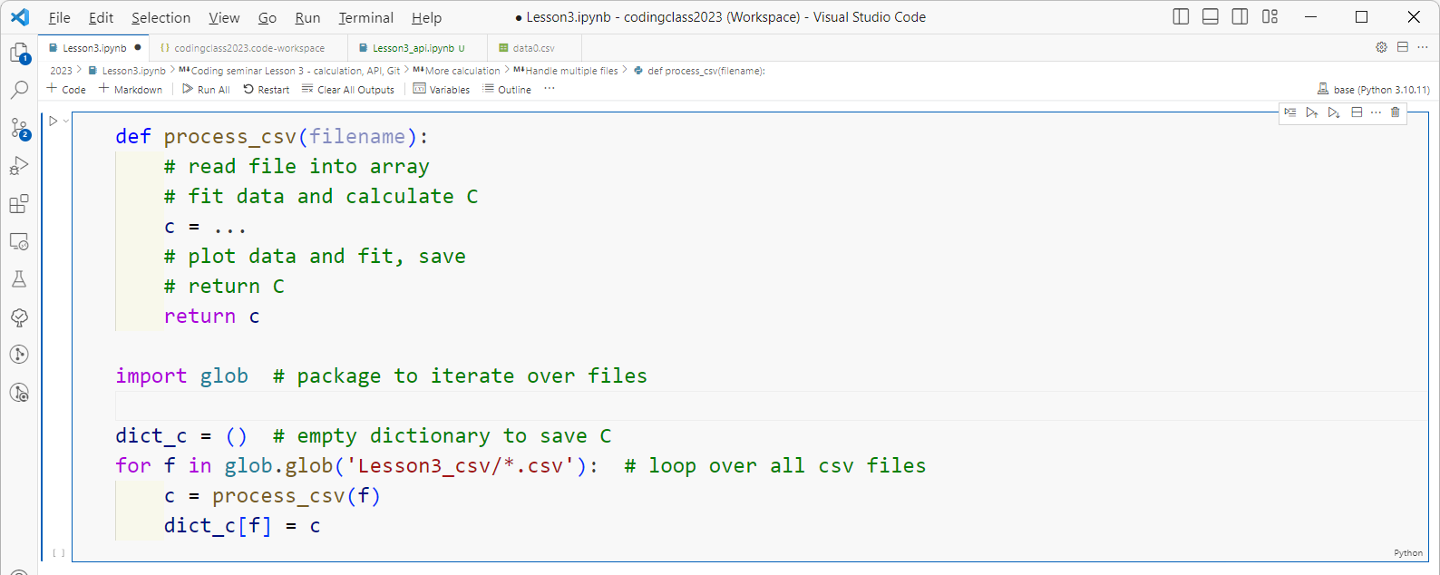
Code structure
*for full code, see https://github.com/ikuehirata/CodingSeminar_IIT_CMI_2023/blob/main/Lesson3.ipynb

Slide 20
API
Application Programming Interface

Slide 21



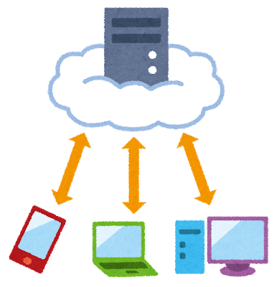





What is API?
Request
“Do this”
Response
“I did that”

Slide 22
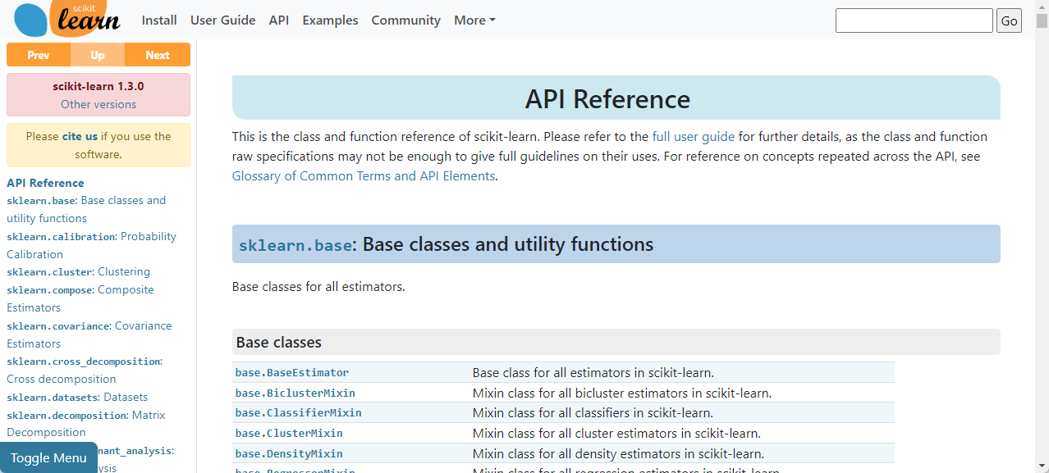
API documents
https://scikit-learn.org/stable/modules/classes.html

Slide 23
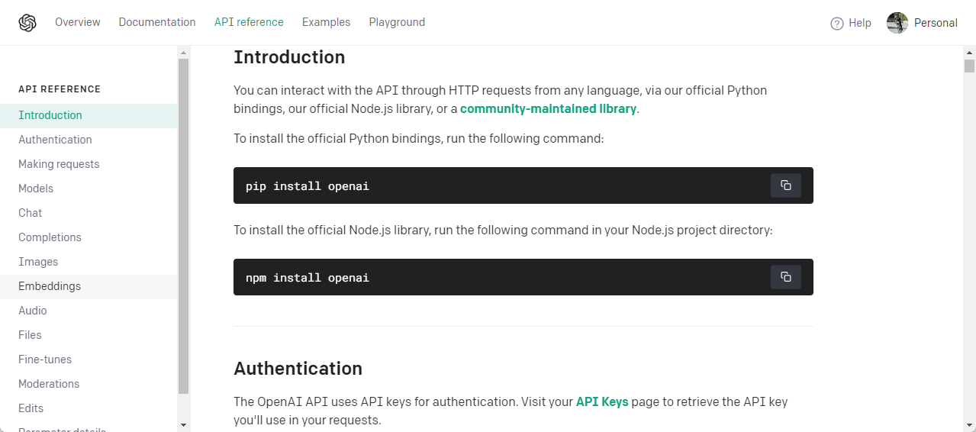
Let’s try ChatGPT API
https://platform.openai.com/docs/api-reference/introduction

Slide 24
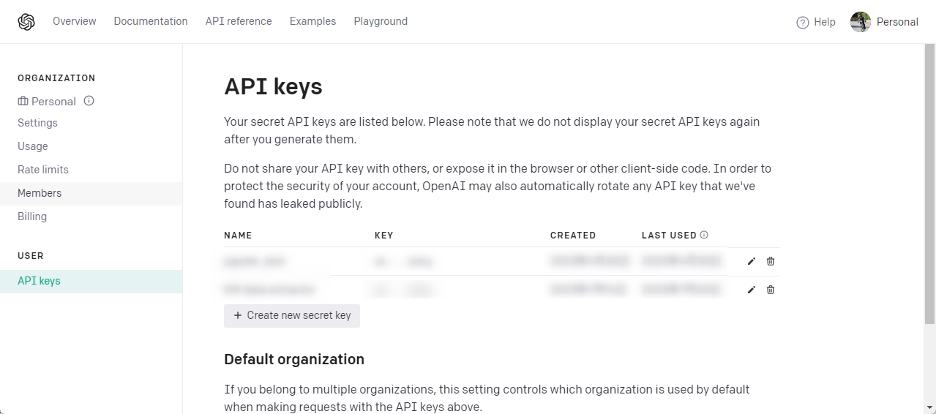
API keys
Identify the requester is you
Calculates how much is used
Limits access in case of heavy load
DO NOT LEAK THEM!

Slide 25
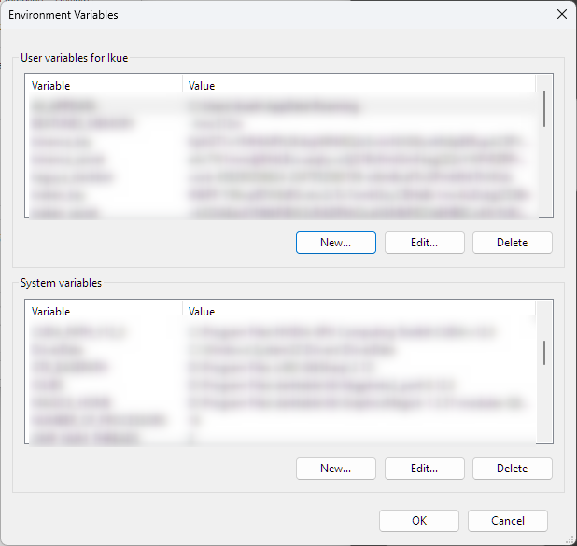
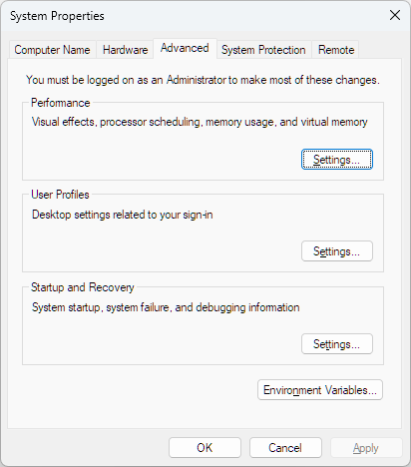
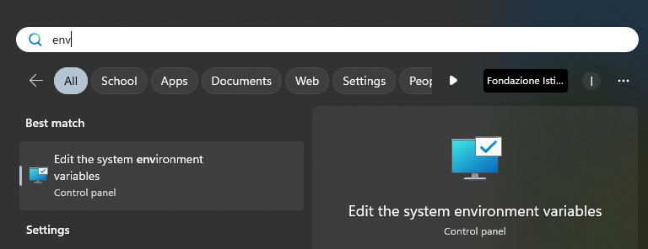
Do not write API keys on your code
Store it in Environment Variables
Reboot VS Code

Slide 26
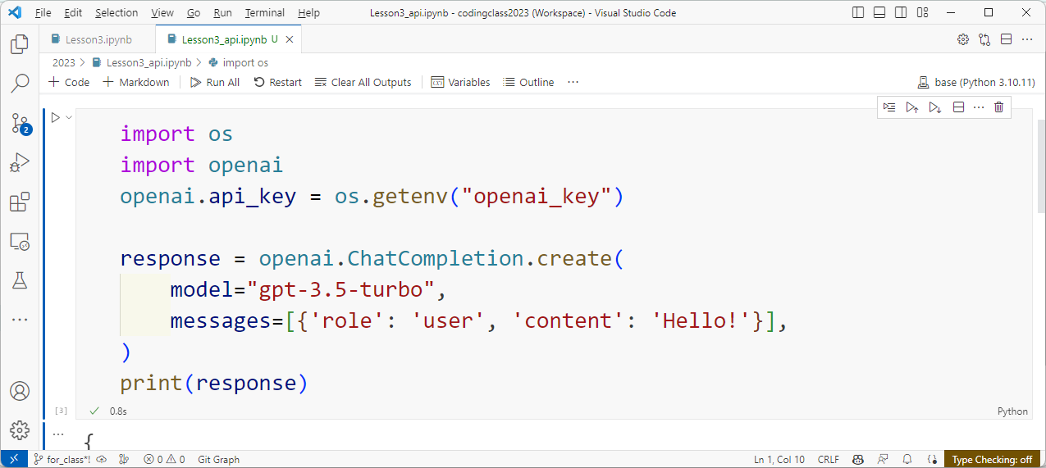
Minimal code
Your question

Slide 27
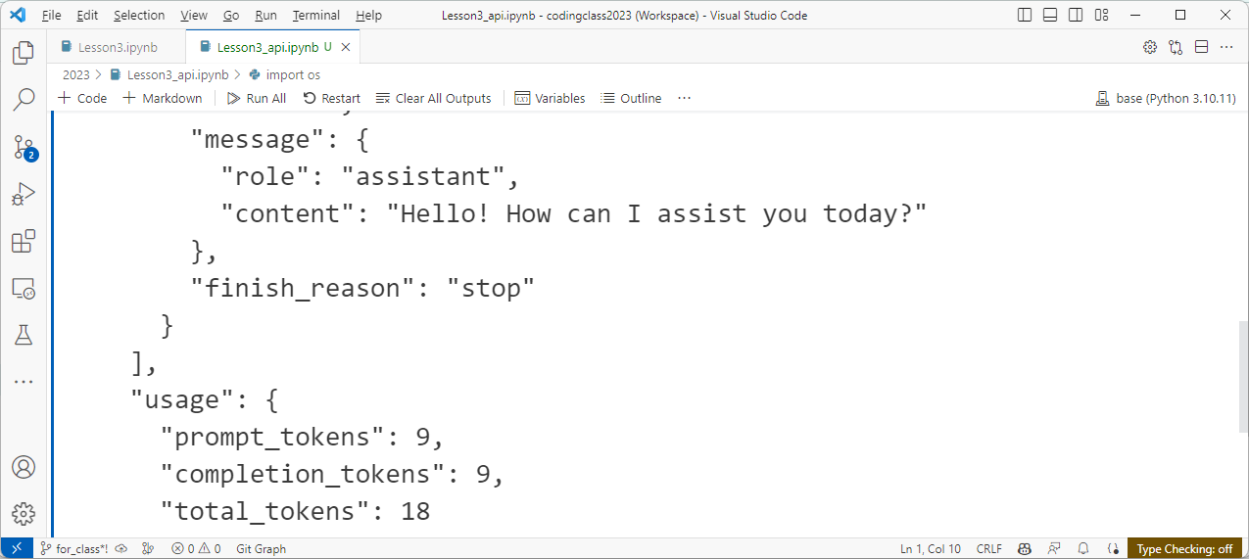
Response
ChatGPT’s response
How many tokens are used in this conversation
This is approx. $0.0000315 (see Pricing)

Slide 28




API use case
Run query search
Ask summarize abstracts
Return summaries
Send summaries
Return result
https://script.google.com/home/projects/1M6yhI6PTaFpvcZeRVycmJZoh2LhUL_Zk64pxwDYCLjD1K14Qirf7Nov-
https://slide.antaa.jp/article/view/d0de1bd8ea414420#8

Slide 29




Platform as a Service (PaaS)
Provides development platform as a whole
No need to manage server
Ref: Saas, Iaas

Slide 30
Git
Version control and collaboration

Slide 31
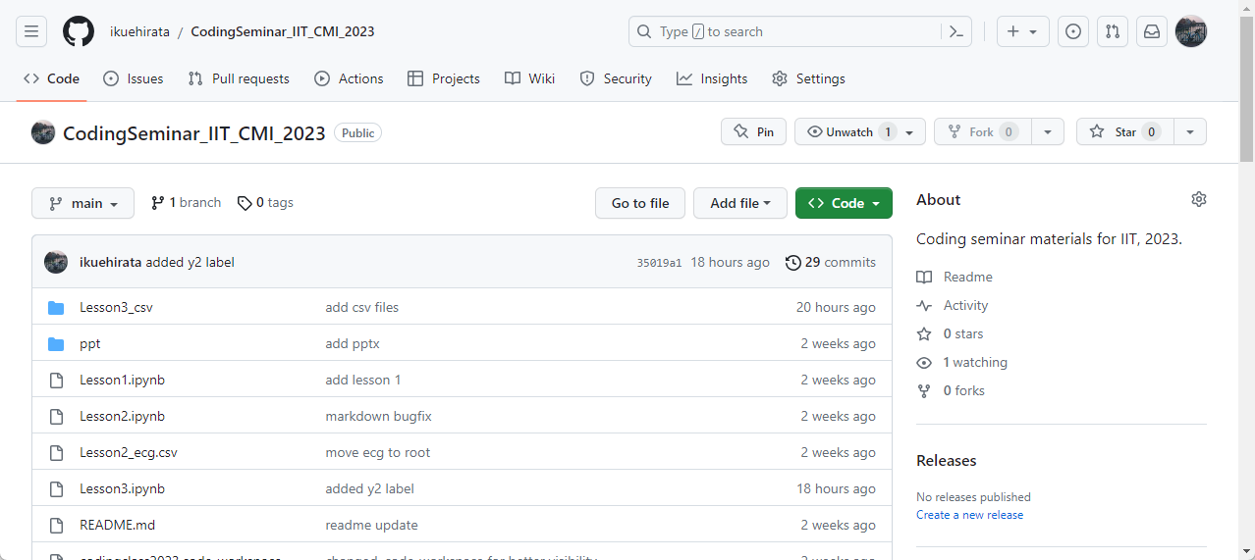
GitHub
Repository to publish your work (in progress)
All source code/histories are shown

Slide 32

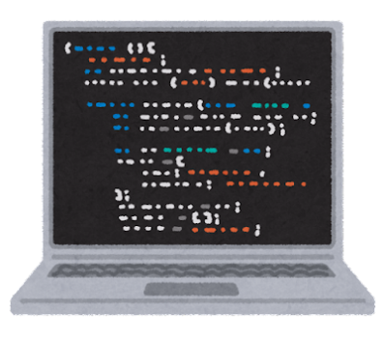
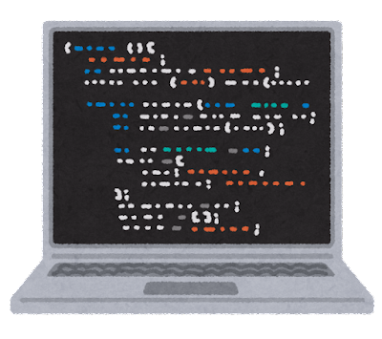
Version control by Git and hosting service
Remote
Local
Git
https://git-scm.com/

Slide 33
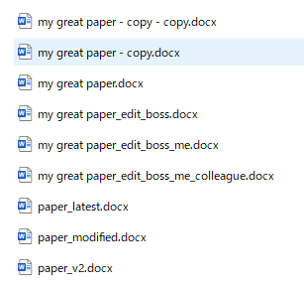
Why is version control needed?
Systematically control edits
Revert to any point of past
Cherry-pick edits
Does not need all-time sync

Slide 34
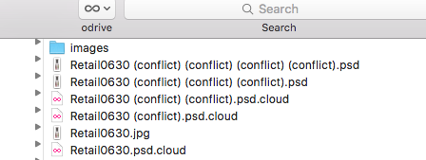



Office sync
Conflict!
B edits more
C edits
A edits more
B edits
A makes body

Slide 35

Git’s idea: branching
https://git-scm.com/about

Slide 36
Git version control
A accepts request, merges, resolves conflict
A accepts request, merges
A accepts request, merges
B edits more,
pull request
C edits, pull request
B edits
A edits, pull request
A makes body

Slide 37
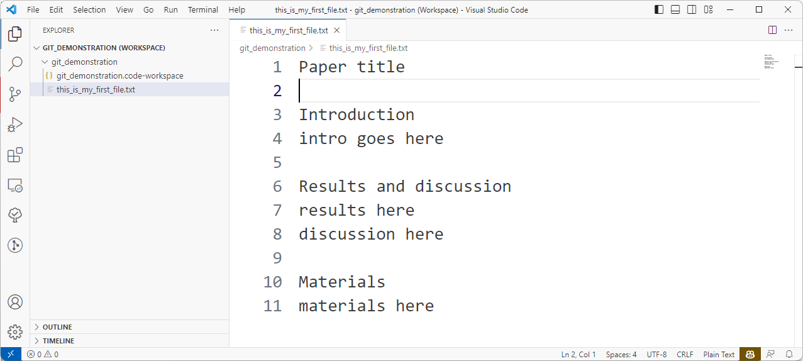
New folder and new file

Slide 38
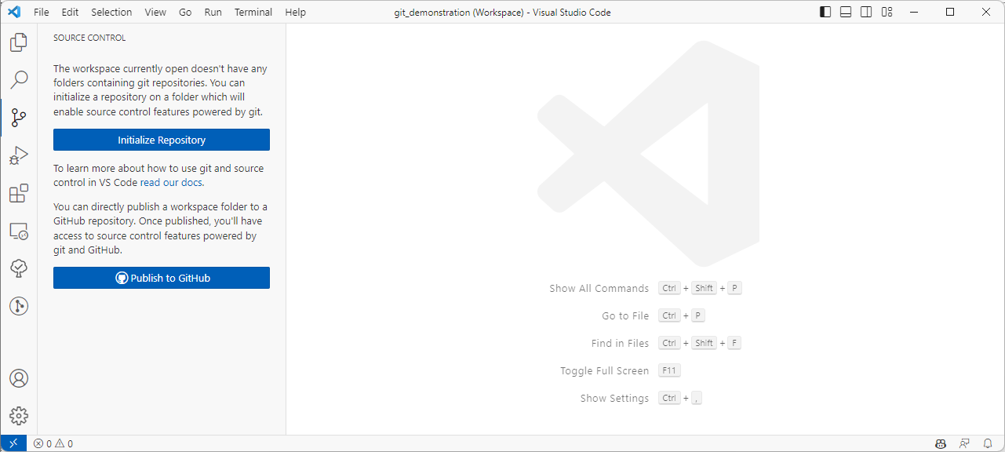
Make a new repository

Slide 39
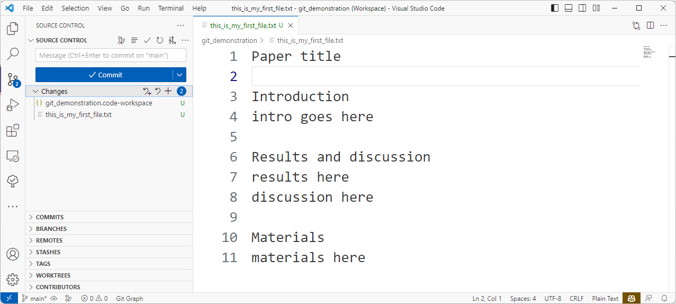
Stage

Slide 40
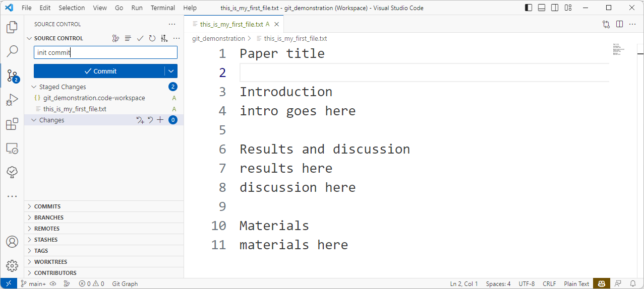
Initial commit

Slide 41
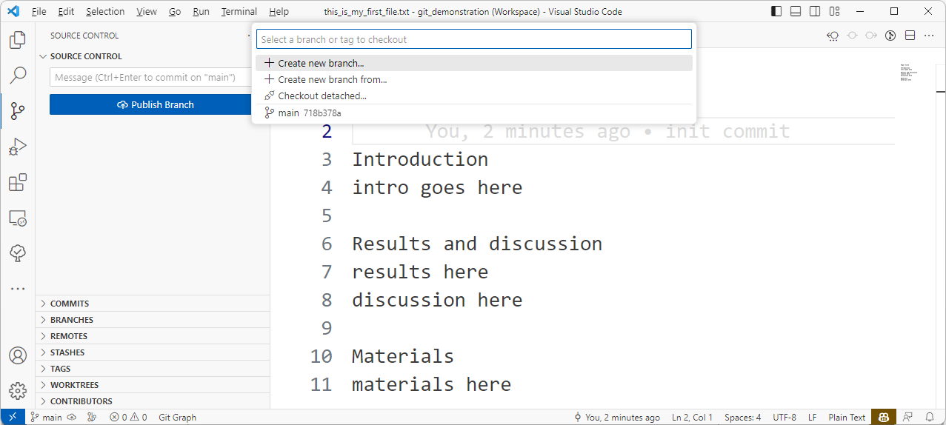
Make a branch

Slide 42
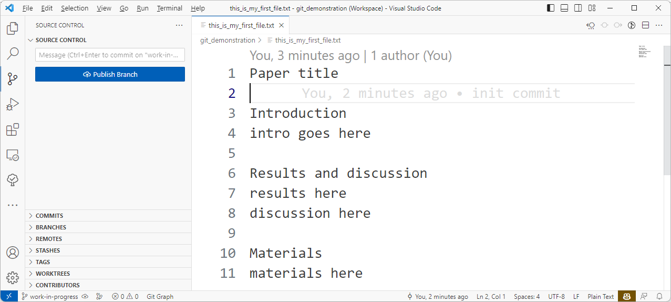
Checkout to new branch

Slide 43
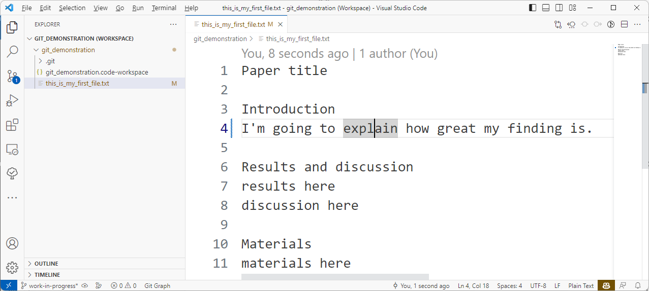

Edit

Slide 44
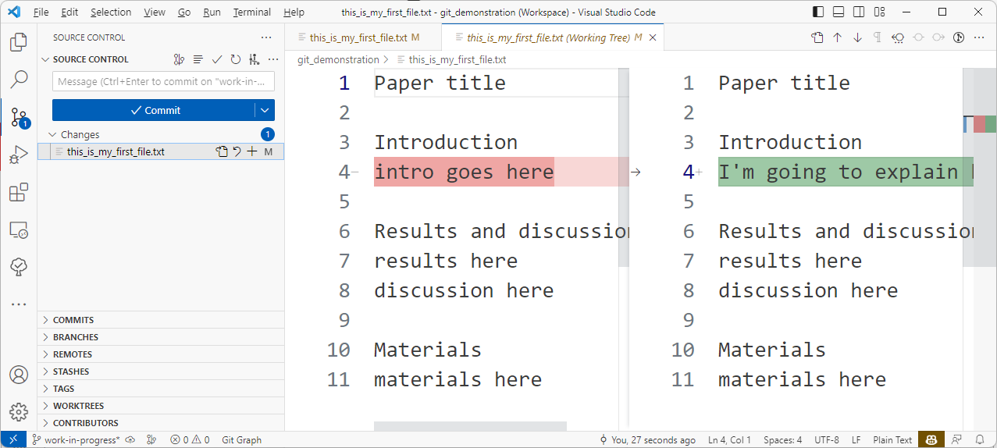
Check what to stage

Slide 45
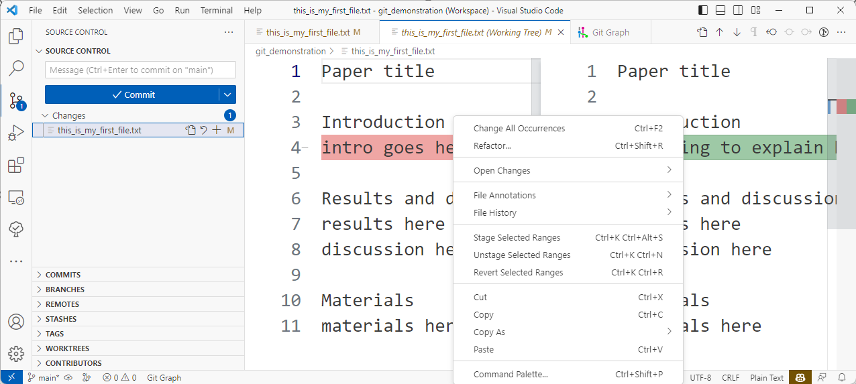
Unstage/revert

Slide 46
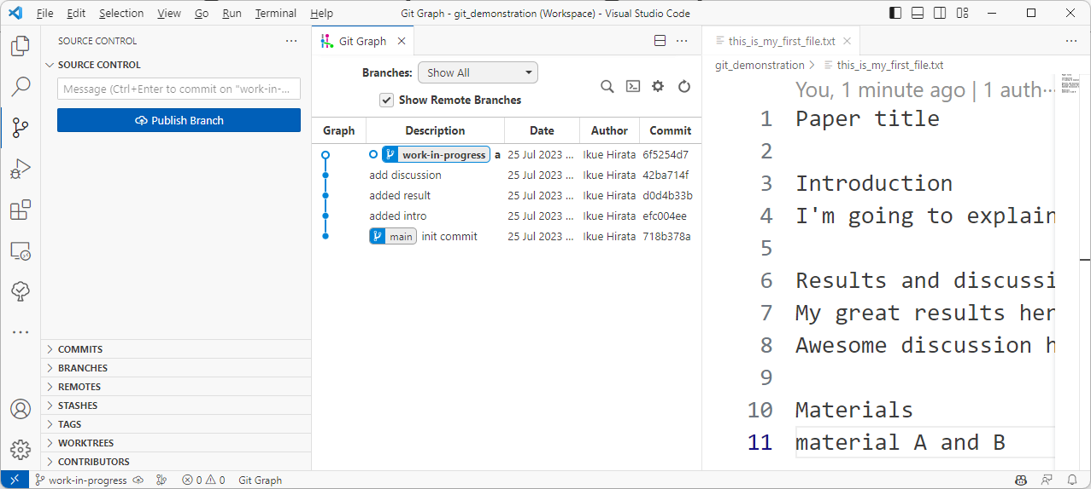

Add commit per small steps
You can cherry pick/drop single commit

Slide 47
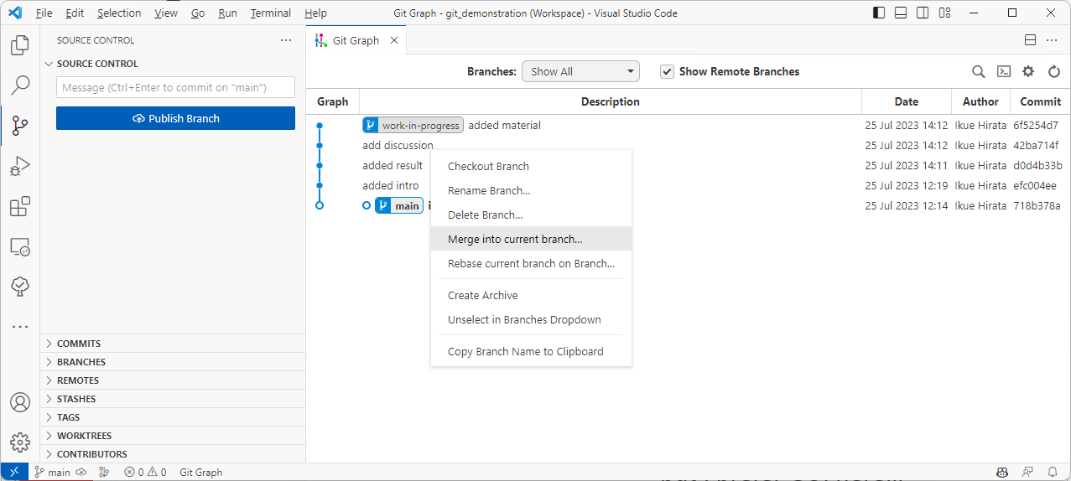
Merge
Can be done with command pallet
Shift + Ctrl + [P] but I prefer GUI here…

Slide 48
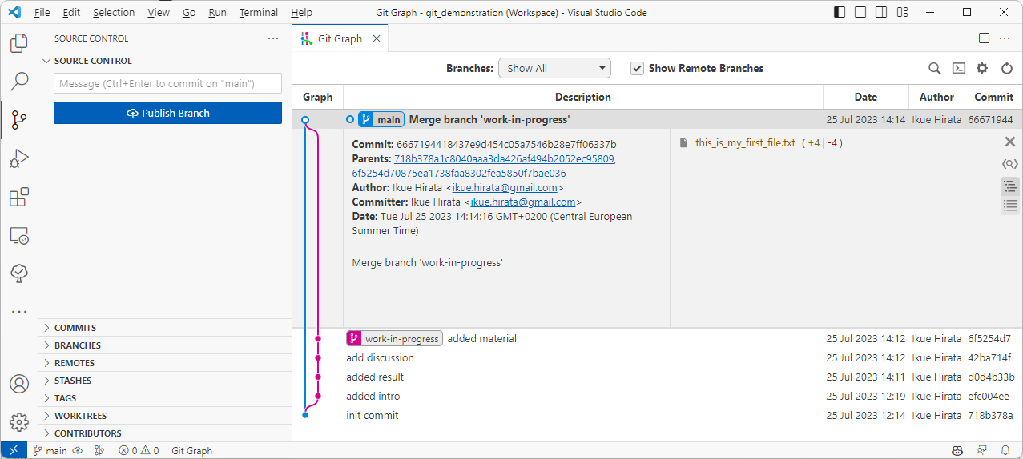
Merge overview

Slide 49
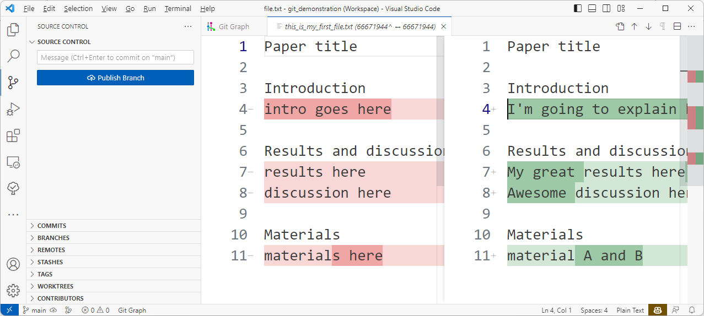
Merge details

Slide 50
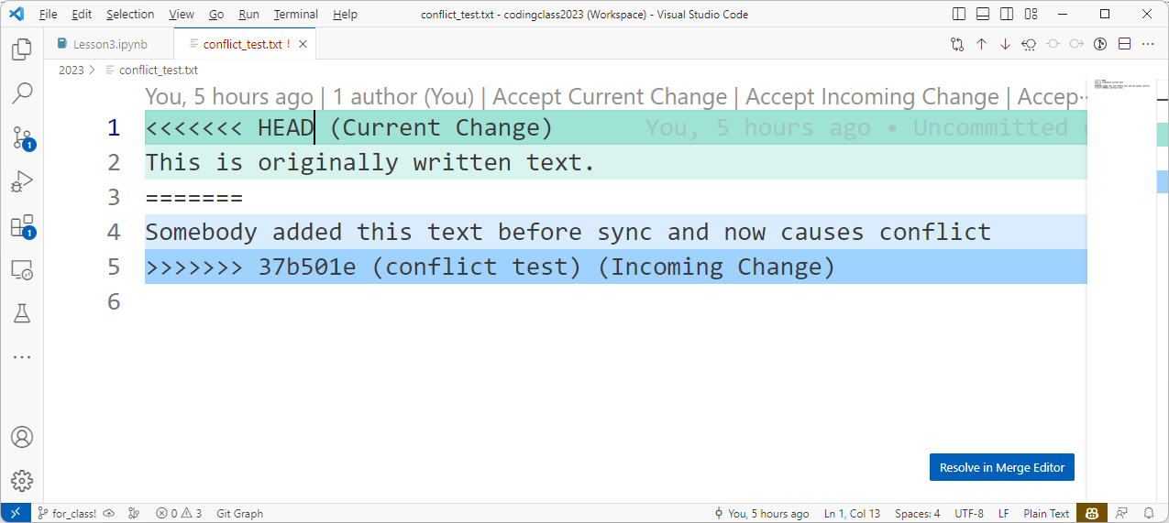
Conflict

Slide 51
Push to/pull from remote repository
Remote
Pull
Push
Local
Pull
Pull

Slide 52
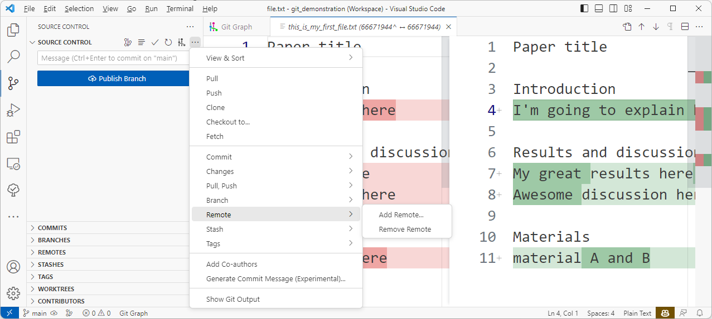
Setup where you want to push

Slide 53
Publish the project to remote repository

Slide 54


Remote repositories
Owned by Microsoft
Free: public Paid: private
Used as training data for GitHub Copilot
Owned other entity
Privacy policy by the owner
https://gitlab.iit.it/

Slide 55
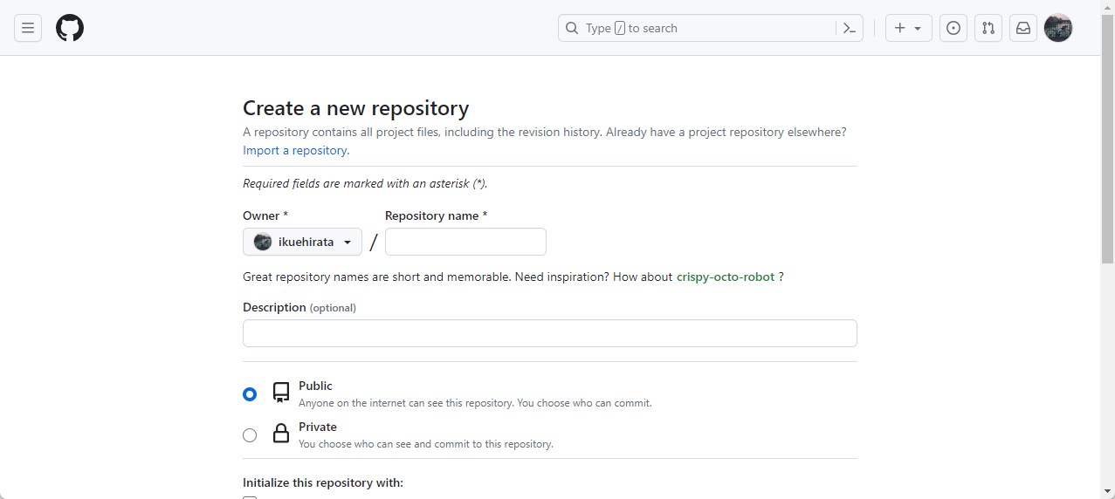
Create your own repository to push

Slide 56
Clone
Some project
When you want to work on existing project
“Pull Request” to original repository
Pull request
Clone
Your own
Push

Slide 57
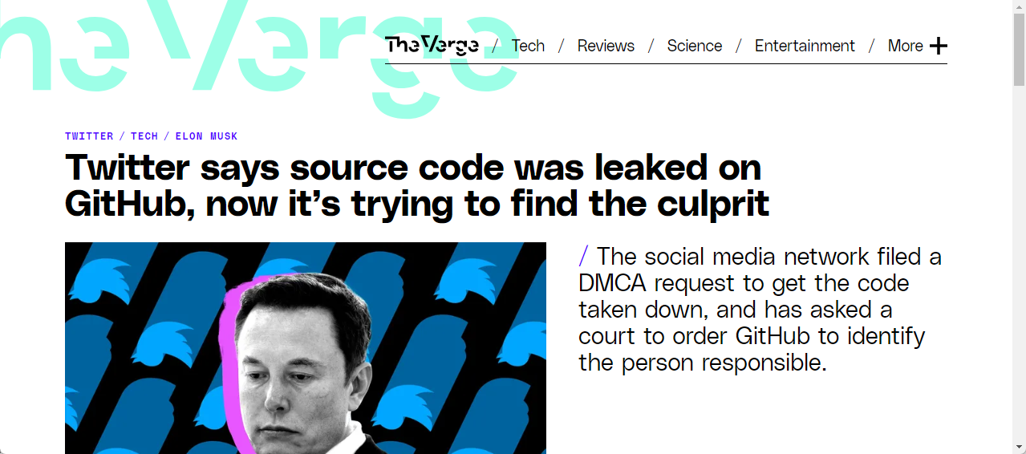
GitHub is public – be cautious!
https://www.theverge.com/2023/3/27/23657928/twitter-source-code-leak-github

Slide 58
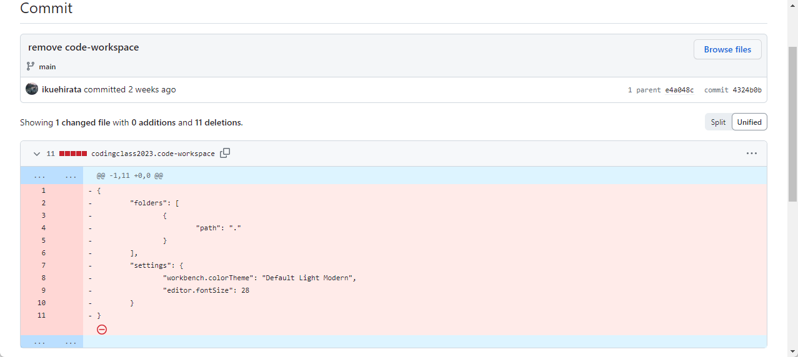
Deletion also can be seen
Do not put your
API keys/tokens
IP address
Bank info
Other sensitive info

Slide 59
Best practice
Store it in Environment Variables

Slide 60
If you find incident, revoke it

Slide 61
Reference
The Missing Semester of Your CS Education (Version Control)
MIT class covering things you need to know before taking Computer Science course
Introduction to Git in VS Code
Google
Stack Exchange, medium, etc.

Slide 62
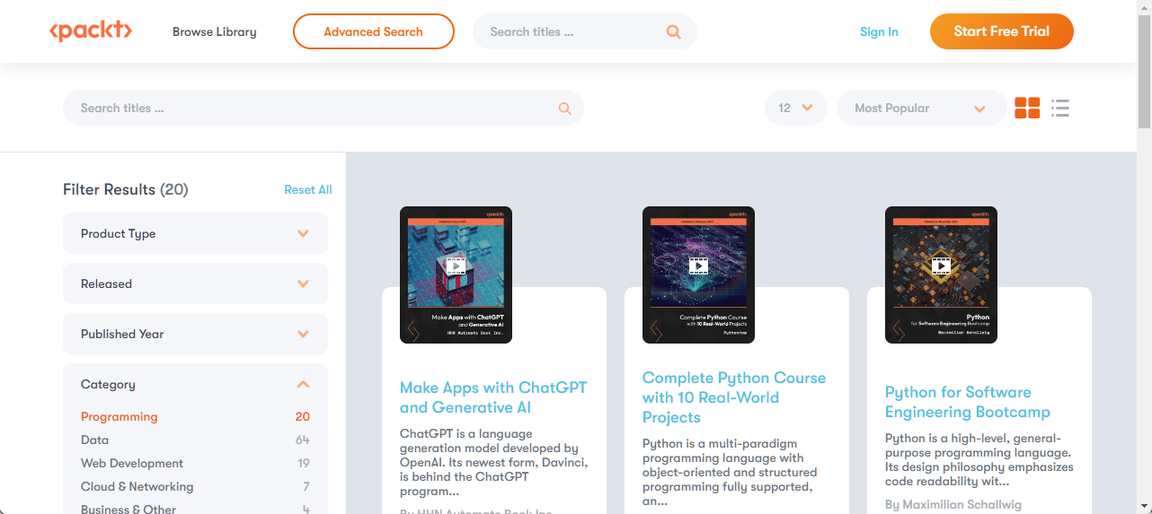
Packt library is free 24-28 Jul
https://subscription.packtpub.com/search?category=Programming&language=python

